Slide 1
Entity Framework Core
Entity Framework Core is a data access technology.
Entity Framework Core is the new version of Entity Framework after EF 6.x.
It is open-source, lightweight, extensible and a cross-platform version.
Entity Framework is an Object/Relational Mapping (O/RM) framework.
It is an enhancement to ADO.NET
Entity Framework gives developers an automated mechanism for accessing & storing the data in the database.
EF Core is intended to be used with .NET Core applications. However, it can also be used with standard .NET 4.5+ framework based applications.

Slide 2
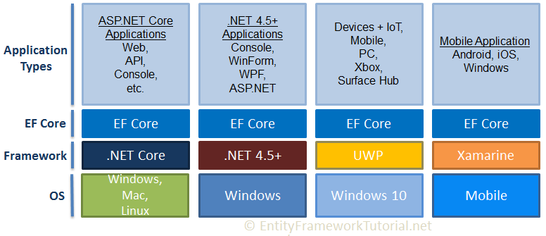
Entity Framework Core

Slide 3
EF Core Version History
EF Core Version | Release Date
EF Core 2.0 | August 2017
EF Core 1.1 | November 2016
EF Core 1.0 | June 2016
EF Core on GitHub: https://github.com/aspnet/EntityFrameworkCore
EF Core Roadmap: docs.microsoft.com/en-us/ef/core/what-is-new/roadmap
EF Core Official Documentation: https://docs.microsoft.com/ef/core

Slide 4
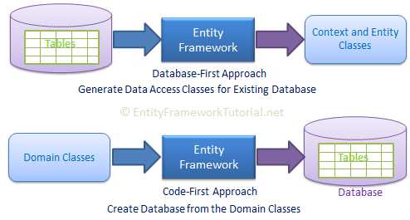
EF Core Development Approaches
EF Core supports two development approaches
1) Code-First
2) Database-First.
EF Core mainly targets the code-first approach and provides little support for the database-first approach.
In the code-first approach, EF Core API creates the database and tables using migration based on the conventions and configuration provided in your domain classes. This approach is useful in Domain Driven Design (DDD).
In the database-first approach, EF Core API creates the domain and context classes based on your existing database using EF Core commands. This has limited support in EF Core as it does not support visual designer or wizard.

Slide 5
EF Core vs EF 6
Entity Framework Core is the new and improved version of Entity Framework for .NET Core applications. EF Core is new, so still not as mature as EF 6.
EF Core continues to support the following features and concepts, same as EF 6.
DbContext & DbSet
Data Model
Querying using Linq-to-Entities
Change Tracking
SaveChanges
Migrations

Slide 6
EF Core vs EF 6
EF Core Database Providers
Entity Framework Core uses a provider model to access many different databases. EF Core includes providers as NuGet packages which you need to install.
The following table lists database providers and NuGet packages for EF Core.
Database | NuGet Package
SQL Server | Microsoft.EntityFrameworkCore.SqlServer
MySQL | MySql.Data.EntityFrameworkCore
PostgreSQL | Npgsql.EntityFrameworkCore.PostgreSQL
SQLite | Microsoft.EntityFrameworkCore.SQLite
SQL Compact | EntityFrameworkCore.SqlServerCompact40
In-memory | Microsoft.EntityFrameworkCore.InMemory

Slide 7
Install Entity Framework Core
Entity Framework Core can be used with .NET Core or .NET 4.6 based applications.
EF Core is not a part of .NET Core and standard .NET framework. It is available as a NuGet package. You need to install NuGet packages for the following two things to use EF Core in your application:
EF Core DB provider
EF Core tools
PM> Install-Package Microsoft.EntityFrameworkCore.SqlServer
PM> Install-Package Microsoft.EntityFrameworkCore.Tools

Slide 8
Entity Framework Core: DbContext
The DbContext class is an integral part of Entity Framework. An instance of DbContext represents a session with the database which can be used to query and save instances of your entities to a database. DbContext is a combination of the Unit Of Work and Repository patterns.
DbContext in EF Core allows us to perform following tasks:
Manage database connection
Configure model & relationship
Querying database
Saving data to the database
Configure change tracking
Caching
Transaction management
To use DbContext in our application, we need to create the class that derives from DbContext, also known as context class. This context class typically includes DbSet<TEntity> properties for each entity in the model.
entities
public DbSet<Student> Students { get; set; }
public DbSet<Course> Courses { get; set; } }

Slide 9
Entity Framework Core: DbContext
DbContext Entity set Methods
Method | Usage
Add | Adds a new entity to DbContext with Added state and starts tracking it. This new entity data will be inserted into the database when SaveChanges() is called.
Find | Finds an entity with the given primary key values.
Remove | Sets Deleted state to the specified entity which will delete the data when SaveChanges() is called.
SaveChanges | Execute INSERT, UPDATE or DELETE command to the database for the entities with Added, Modified or Deleted state.
Update | Attaches disconnected entity with Modified state and start tracking it. The data will be saved when SaveChagnes() is called.

Slide 10
Adding a Migration
EF Core includes different migration commands to create or update the database based on the model.
we need to create the database from the model (entities and context) by adding a migration.
We can execute the migration command using NuGet Package Manger Console as well as dotnet CLI (command line interface).
In Visual Studio, open NuGet Package Manager Console from Tools -> NuGet Package Manager -> Package Manager Console and enter the following command:
PM> add-migration CreateSchoolDB
After creating a migration, we still need to create the database using the update-database command in the Package Manager Console, as below.
PM> update-database –verbose
Note:This was the first migration to create a database. Now, whenever we add or update domain classes or configurations, we need to sync the database with the model using add-migration and update-database commands.

Slide 11
Creating a Model for an Existing Database in Entity Framework Core
PM> Scaffold-DbContext "Data Source=SANTU\MSSQLSERVER2019;Initial Catalog=Training1DB;Integrated Security=TrueMicrosoft.EntityFrameworkCore.SqlServer -OutputDir Models
Update models when tables are updated
PM> Scaffold-DbContext "Server=.\SQLExpress;Database=SchoolDB;Trusted_Connection=True;" Microsoft.EntityFrameworkCore.SqlServer -OutputDir Models -force

Slide 12
Stored Procedure in Entity Framework Core
EF Core provides the following methods to execute a stored procedure:
DbSet<TEntity>.FromSqlRaw()
DbContext.Database.ExecuteSqlRaw()
Ex: context.Database.ExecuteSqlRaw("CreateStudents @p0, @p1", parameters: new[] { "Bill", "Gates" });

